Slide 1

INSTITUTE - UIE
DEPARTMENT- ACADEMIC UNIT-2
Bachelor of Engineering (Computer Science & Engineering)
Subject Name: Introduction to Problem Solving
Code:22CSH-101
Jump Statements
DISCOVER . LEARN . EMPOWER

Slide 2


Introduction to Problem Solving
Course Objectives
The course aims to provide exposure to problem-solving through programming.
The course aims to raise the programming skills of students via logic building capability.
With knowledge of C programming language, students would be able to model real world problems.

Slide 3



CO Number | Course Outcome
CO1 | Remember the concepts related to fundamentals of C language, draw flowcharts and write algorithm/pseudocode.
CO2 | Understand the way of execution and debug programs in C language.
CO3 | Apply various constructs, loops, functions to solve mathematical and scientific problem.
CO4 | Analyze the dynamic behavior of memory by the use of pointers.
CO5 | Design and develop modular programs for real world problems using control structure and selection structure.

Slide 4
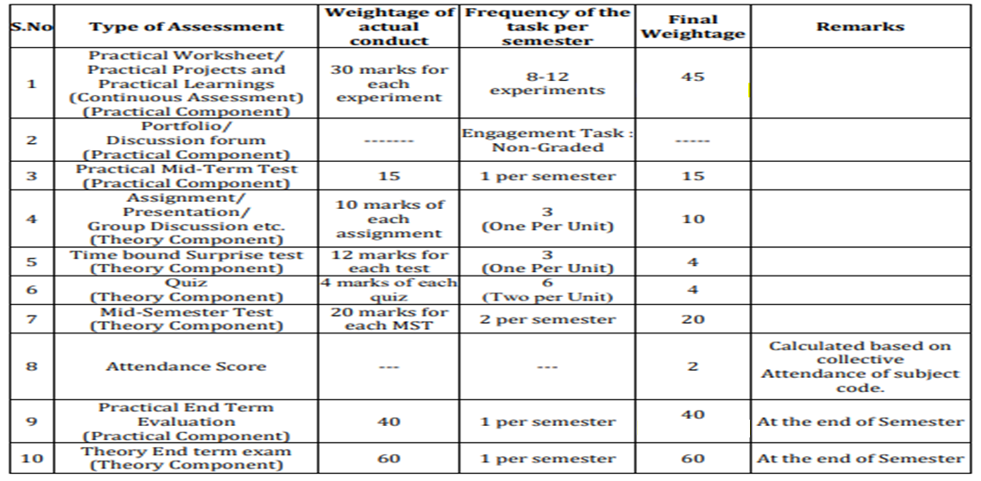
Scheme of Evaluation

Slide 5
Contents
Jump statements
break
continue
goto
return

Slide 6
Jump Statements
I/O Statements
Jump statements can be used to modify the behavior of conditional and iterative statements
They allow you to exit a loop, start the next iteration of a loop, or explicitly transfer program control to a specified location in your program.

Slide 7
I/O types
Types of Jump statements
They are of four types:-
Break
Continue
goto
Return

Slide 8
Loops Definition & Syntax
Statements | Definition & Syntax
Break | A break statement is used to terminate the execution of the rest of the block where it is present and takes the control out of the block to the next statement. Syntax: break;
Continue | Continue statement like any other jump statements interrupts or changes the flow of control during the execution of a program. Syntax: continue;
goto | This jump statement is used to transfer the flow of control to labeled statement in the program. Syntax: goto <label>; This label indicates the location in the program where the control jumps to.to.
Return | This jump statement is usually used at the end of a function to end or terminate it with or without a value. Syntax: return<expression>;

Slide 9
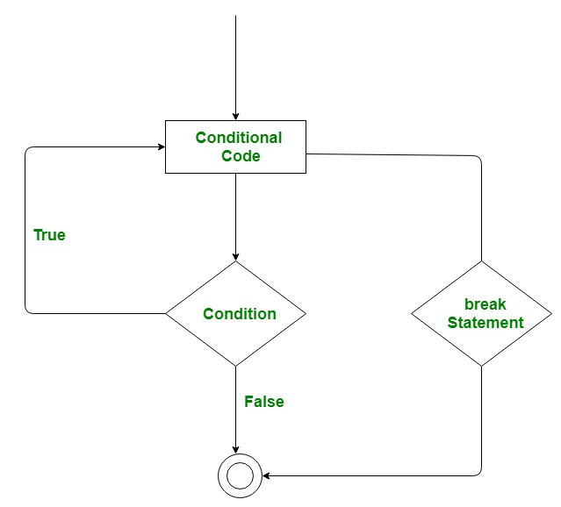
Break statement
F
The break statement is used to terminate the loop or statement in which it present. After that, the control will pass to the statements that present after the break statement, if available. If the break statement present in the nested loop, then it terminates only those loops which contains break statement.
Flowchart of break statement

Slide 10
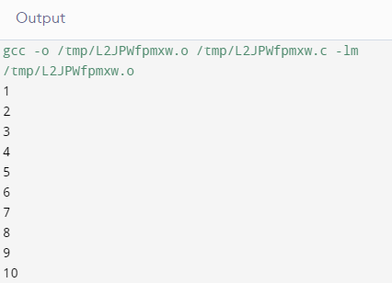
Example
Example 1: Program to print first 15 natural numbers
#include <stdio.h>
int main()
{
int i;
for(i=1;i<=15;i++)
{
printf("%d\n",i);
if(i==10)
break;
}
return 0;
}

Slide 11
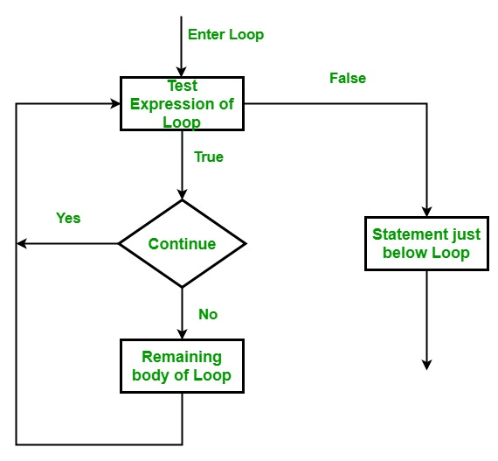
Continue statement
This statement is used to skip over the execution part of the loop on a certain condition. After that, it transfers the control to the beginning of the loop. Basically, it skips its following statements and continues with the next iteration of the loop.
Flowchart of continue statement

Slide 12
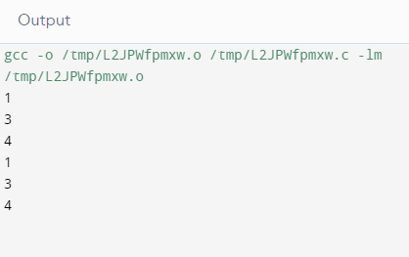
Example
In this program, we see that the printf() instruction for the condition j=2 is skipped each time during the execution because of continue. We also see that only the condition j=2 gets affected by the continue. The outer loop runs without any disruption in its iteration.
Write a c program to print numbers #include <stdio.h>
int main()
{
int i,j;
for(i=1;i<3;i++)
{
for(j=1;j<5;j++)
{
if(j==2)
continue;
printf("%d\n",j);
}
}
return 0;
}

Slide 13
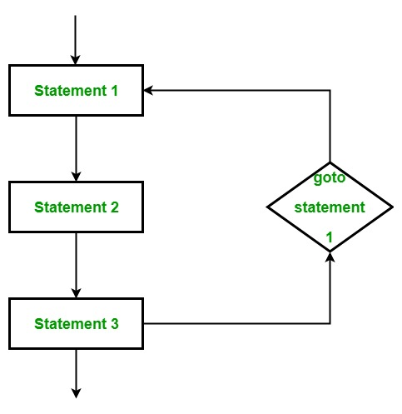
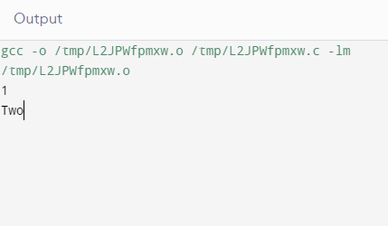
goto statement
Flowchart of continue statement
This statement is used to transfer control to the labeled statement in the program. The label is the valid identifier and placed just before the statement from where the control is transferred.
Example: #include <stdio.h>
int main()
{
int i,j;
for(i=1;i<5;i++)
{
if(i==2)
goto there;
printf("%d\n",i);
}
there:
printf("Two");
return 0;
}
In this program, we see that when the control goes to the goto there; statement when i becomes equal to 2 then the control next goes out of the loop to the label(there: ) and prints Two.

Slide 14
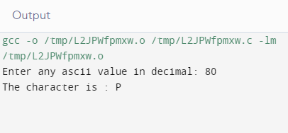
Return statement
This statement terminates the execution of the method and returns the control to the calling method. It returns an optional value. If the type of method is void, then the return statement can be excluded.
Example: #include <stdio.h>
char func(int ascii)
{
return ((char)ascii);
}
int main()
{
int ascii;
char ch;
printf("Enter any ascii value in decimal: \n");
scanf("%d",&ascii);
ch=func(ascii);
printf("The character is : %c",ch);
return 0;
}
In this program we have two functions that have a return type but only one function is returning a value [func()] and the other is just used to terminate the function[main()].
The function func() is returning the character value of the given number(here 110). We also see that return type of func() is char because it is returning a character value.
The return in main() function returns zero because it is necessary to have a return value here because main has been given the return type int.

Slide 15
Summary
break
It terminate the loop or statement in which it present.
continue
It is used to skip over the execution part of the loop on a certain condition.
Goto
It transfer control to the labeled statement in the program.
return
It terminates the execution of the method and returns the control to the calling method.

Slide 16
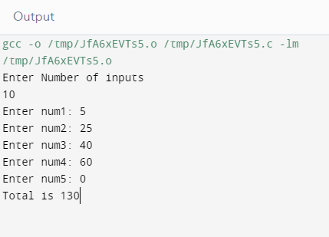
FAQ
Q1 Write a program in C to display the sum of the numbers enter by a user and stop taking input when user enter zero.
#include<stdio.h>
void main()
{
int num, sum=0, i,n;
printf("Enter Number of inputs\n");
scanf("%d",&n);
for(i=1;i<=n;++i)
{
printf("Enter num%d: ",i);
scanf("%d",&num);
if(num==0)
{
break; /*this breaks loop if num == 0 */
printf("Loop Breaked\n");
}
sum=sum+num;
}
printf("Total is %d",sum);
getch();}

Slide 17
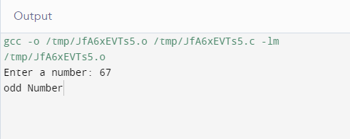
FAQ
Q2 Write a program to check if a number is even or not and print using the goto statement.
#include <stdio.h>
int main()
{
int num;
printf("Enter a number: ");
scanf("%d",&num);
if (num % 2==0)
goto even;
else
goto odd;
even:
printf("even Number");
Odd:
printf("odd Number");
return 0;
}

Slide 18
Assessment Questions
1. #include<stdio.h> int main() { int x; for(x=1;x<=10;x++) { if(x%2==1) continue; printf("\t%d",x); } return 0; } | 2. #include<stdio.h> int main() { int x=1; for(;;) { if(x>5) break; printf("\t%d",x++); } return 0; }
3. The break statement is used in? a) for loop b)switch statement c) while loop d)None of the above | 4. #include <stdio.h>" int main() { int i; goto LOOP; for (i = 0 ; i < 10 ; i++) { printf("GeeksQuizn"); LOOP: break; } return 0; }

Slide 19
References
Book References:
https://www.pdfdrive.com/learn-to-program-with-c-learn-to-program-using-the-popular-c-programming-language-e166650744.htmlhttp://www2.cs.uregina.ca/~hilder/cs833/Other%20Reference%20Materials/The%20C%20Programming%20Language.pdf
http://www.freebookcentre.net/programming-books-download/The-Basics-of-C-Programming.html
Vedio Lecture: http://www.digimat.in/nptel/courses/video/106104128/L17.html
https://spoken-tutorial.org/watch/C+and+Cpp/Loops/English/
https://www.youtube.com/watch?v=67TlTBT68LE
https://www.youtube.com/watch?v=Bv1LcqhqnZs
Websites: https://www.cs.auckland.ac.nz/references/unix/digital/AQTLTBTE/DOCU_075.HTM
https://www.programiz.com/c-programming/c-goto-statement
https://www.geeksforgeeks.org/c-sharp-jump-statements-break-continue-goto-return-and-throw/

Slide 20
THANK YOU

